Slide 1

Arthro
Cure
Codezillas
University of Moratuwa

Slide 2
GAME ADDICTION
ARTHRITIS
OUR SOLUTION
CURE

Slide 3
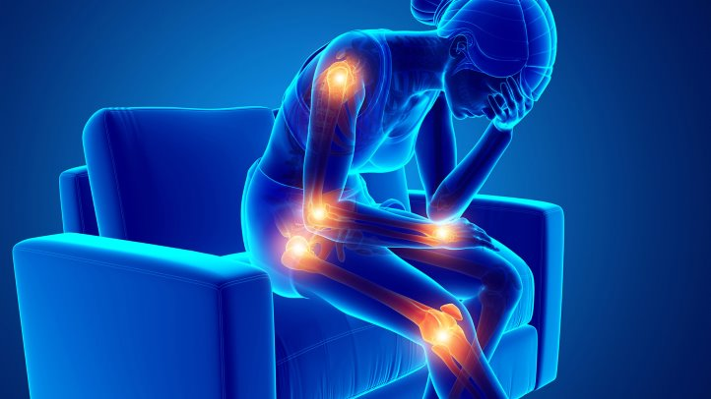
ART HRITIS

Slide 4
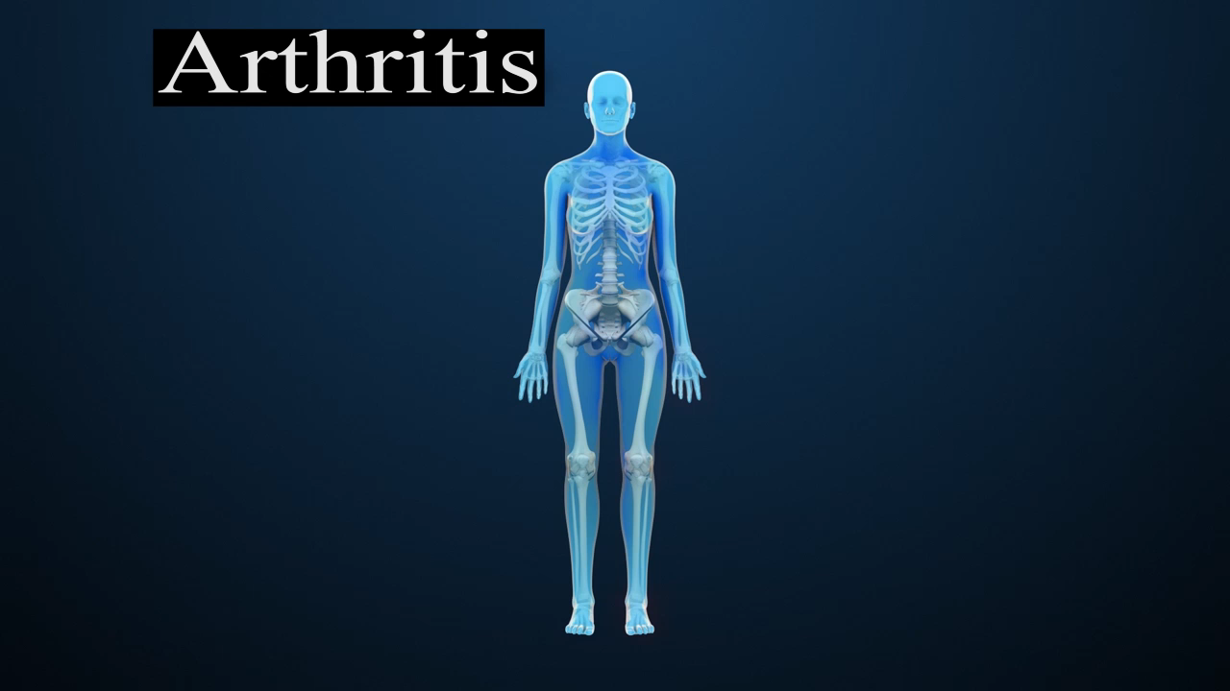

Slide 5
Worldwide Survey
Approximately 350 million people
180 million adults
54.4 million adults
Sources:
www.arthritis.org, www.arthritis-india.com

Slide 6



Per 10,000
National Survey
Health in Sri Lanka
Age Group | Arthritis
<15 | 3
15-24 | 22
25-34 | 33
35-44 | 95
45-54 | 303
55-64 | 544
>65 | 887

Slide 7
ArthroCure
Customer Validation
Unity 3D
Windows
Kinect sensor
Revenue
Investment
Technical
Business
Target
MacOS
Channel
Marketing
Linux
Update frequently

Slide 8
Key Partners Hospitals Rheumatologists Arthritis patients Pharmacists Game Store | Key Activities Game development and management Marketing and holding awareness program Customer support | Value Proposition Trust |  | Customer Relationships Social media Customer support Feedback | Customer Segments
 |  |  |  | Channels Hospitals Health Department Social media Pharmacy Game Stores
 | Key Resources Kinect sensor Employees Data Tech platform |  |  | Channels Hospitals Health Department Social media Pharmacy Game Stores
Cost Structure Technological infrastructure Awareness program and marketing expenditure Salaries to permanent employees |  |  | Revenue Streams Monthly subscription from game users Funds from Arthritis Organizations
No more medicines
PATIENTS - Those in initial and secondary state
Low price compared to surgery
DOCTORS
- Rheumatologists
Can monitor the health improvement
VIDEO GAME ADDICTS

Slide 9

Xbox Kinect Games??

Slide 10
Our Future Plans ….
2019
….
Other Diseases
Arthrocure
Different
Platforms
Ultimate
Target
2018
2021

Slide 11



Sources…
Mentor :
DR. Uthayasanker Thayasivam
PhD (U. Georgia), BSc Eng. (Hons) (Moratuwa)
rtuthaya@cse.mrt.ac.lk
+94 (76) 394 6578
Doctor :
DR. Viveganandarajah Rennu Priakshan
MD (Odessa national medical university)
priakshanvive@gmail.com
+94 (76) 220 6882

Slide 12

Thank You

Slide 13
ONLY ARTHRITIS???
Osteoperosis
Fibromyalgia
Coordination impairment

Slide 14


Regular physical Activity
Medicine & Joint replacement
Rest
.
What’s the
Cure ???

Slide 15
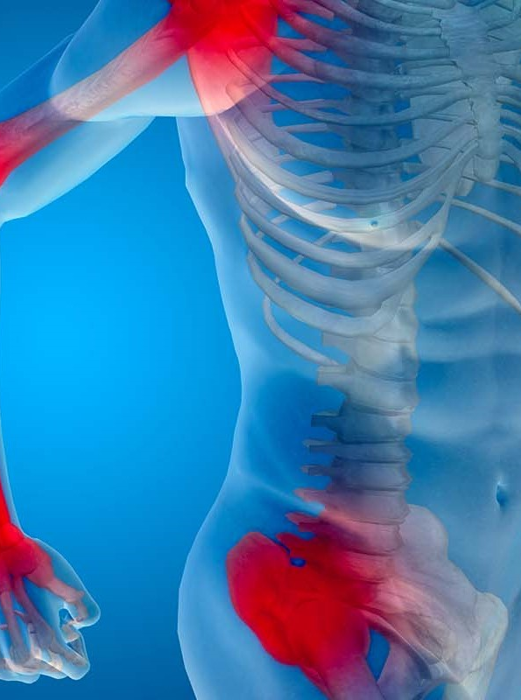

Our solution!
Cure arthritis
Prevent future risks

Slide 16




Ultimate
Goal...!!!
must not feel the pain of exercise
play the game as a game only
should not think that he is a patient

Slide 17
Q&A
Being Female and having a family history of arthritis are factors that make people more likely to get arthritis.

Slide 18
Q&A
There are two types of joint surgery in Srilanka
Semi
Full
These may cost more than about one and a half lakhs.

Slide 19
Q&A
GOVERMENT HOSPITAL IN SRI LANKA | NUMBERS
National Hospital of Sri Lanka | 01
Teaching Hospitals | 19
Provincial General Hospitals | 03
District General Hospitals | 19
Base Hospitals - Type A | 27
Base Hospitals - Type B | 44
Divisional Hospitals - Type A | 70
Divisional Hospitals - Type B | 11
TOTAL | 194
Source :
http://www.health.gov.lk/moh_final/english/hospital_government.php?spid=24

Slide 20
Q&A
Some of the difficulties in Sri Lanka are that:
1.In a week they do only one or two surgeries.
2. Priority is given to patients with more pain.
3.People need to wait even for about six months to get it done in GH.

Slide 21
Q&A
Some of the difficulties:
1.These joints have to be replaced every ten years.
2. Titanium sheets are very expensive

Slide 22
Q&A
Can arthritis be reversed with exercise?
1.Exercise doesn’t reverse damage that’s already done. But it helps prevent arthritis from getting worse and has the added
Benefit of keeping excess pounds off. That can make a huge difference on the joints that support most of the body’s weight

Slide 23
Q&A
Benefits of exercise for Arthritis.
Physical activity is the best non – drug treatment for improving pain and function in OA. While you may worry that exercising with arthritis can harm your joints and cause more pain, research shows that people can and should exercise when they have arthritis.

Slide 24

Q&A
How can you expect Older people to play games?
Study says that the average age of a video gamer is 33years

Slide 25
Q&A
If older people when suffering from arthritis need to do exercise for pain relief, then why cant we expect them to play games.

Slide 26
Q&A
Are you targeting arthritis patients with a Xbox Kinect???
In 2013, the total medical costs and earning losses due to arthritis were equal to more than 1 percent of the U.S. gross domestic product (GDP, about $304 billion).

Slide 27
Q&A
What type of exercises have to be done for an arthritis patient?
Range of motion exercise.
Aerobic exercise like walking & jogging.
Strengthening exercises.

Slide 28
Q&A
How can you justify the cost?
1.Joint surgery
2.Physiotherapist charges 1500/- per visit and mostly they visit once a week.

Slide 29
Q&A
Economics ???
Capital requirement- $50,000 for tooling
Hardware device cost – $85 - $90 /unit
$0.99 for monthly subscription

Slide 30
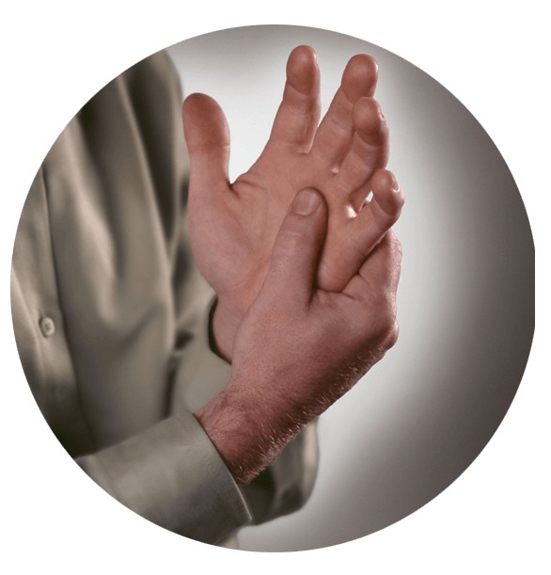
ARTHRITIS ????
Young &
Old
Arthrities.Org
Asia
US
Informal way of referring to Joint Pain
Affects Heart & lungs
Many Types.
Cause of Disability

Slide 31

Game Addiction!!!!!!!
68,000 years

